Slide 1
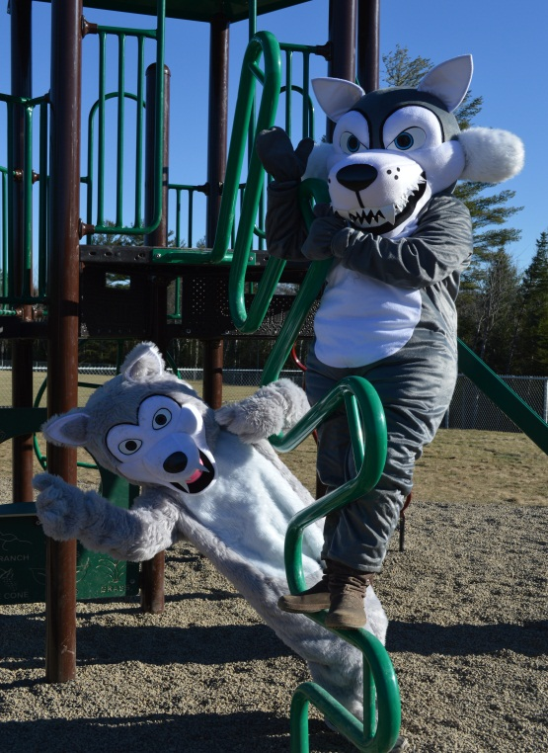
Kindergarten Orientation June, 2021
WELCOME
GNMES
Finding our greatness together!

Slide 3
GNMES CREED
I am responsible. I look after my belongings, my school materials, myself and my learning. I am respectful. I value others, my school and myself. I am safe. I think about the safety of others and myself. I am kind. I show that I care with my actions and my words. I am resilient. I persevere with a positive attitude. This is how I find my greatness!

Slide 4
I can…

Slide 5
A checklist to do with your child.
Independent I Can skills:
I can put on my own Velcro shoes. (no laces please)
I can do my own zippers, buttons, and snaps.
I can do my own wiping, pulling up pants, washing hands after using the toilet.
I can open my snacks.
I can recognize my name on my belongings.
I can recognize my first and last names when printed.
I can say my phone number.
I can print my name.
Feeling independent is empowering for kindergarten students. Please help them be successful by practicing all of these I Can skills.
Notes:
Practice all zippers (coat, backpack, lunch box, pants)
When your child gets something new (shoes, jacket) have them practice putting them on, taking them off at home first.
Velcro

Slide 6
Safe Arrival and Dismissal
Safe Arrival Routines
Students arrive on the bus or in the drop off area outside.
Call the school if your child will be absent.
Dismissal Routines
All students walk outside with their teacher.
Parent pick-up at dismissal time is at the front of the school.
Notes:
The playground is supervised from 7:45.

Slide 7
Transportation
Kiss and Go drop off is marked by pylons.
Bus students – An adult must meet their child at the bus stop, or the driver will return the child to school.
Only one primary and one alternate drop off after school. It helps your child if you are consistent in their after-school plans.
Important to know their address and phone number.
Wednesday is a half day dismissal.
Notes:
Looking out the window is not enough.
24 hour written notice needed for a change in drop off

Slide 8
Personal records
It is very important that all records are kept updated at the school. Tell your child's teacher or call the school if there are updates to any of the following:
Contact information and phone numbers
Immunization records
Legal documentation (custody agreements, medical information)
Notes:
Custody records with directions

Slide 9
What do your children need on their first day of school?
Supply fees $50.00 - please pay through School Cash Online (link is on our school website)
All belongings need to be labeled
Large, sturdy backpack that your child can independently zip and pack
Indoor and outdoor footwear
Change of clothes to be kept at school
Snack and lunch
Water bottle
Notes:
Lunches can not be warmed up.

Slide 10
What to expect in the first week:
Staggered entry is at 9-11 or 12:30-2:30 on Tuesday or Wednesday. (only one time and day for each child)
You will be contacted late June with your staggered entry time and day.
Thursday is a full day for all students.
Meet the teacher is yet to be determined.
We will follow covid protocols as directed by Public Health in August.

Slide 11
School Website
http://gnmes.nbed.nb.ca/
Gibson-Neill Home and School Facebook page
Twitter feed @GNMES_News

Slide 12
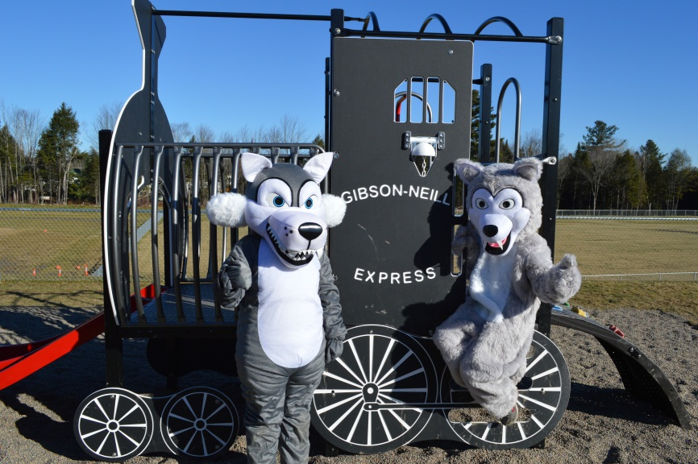
Thank you for viewing this Powerpoint.
We look forward to seeing your children in September.

